Slide 1
KEYLOGGER
CYBER SECURITY PROJECT
Presented By:
Melvin Jones E - Jeppiaar Institute of Technology – B.E/ CSE

Slide 2
OUTLINE
Problem Statement
Proposed System/Solution
System Development Approach
Algorithm & Deployment
Result
Conclusion
Future Scope
References

Slide 3
PROBLEM STATEMENT
In today's digital landscape, keyloggers present a pervasive cybersecurity threat by clandestinely recording user keystrokes. These malicious tools compromise sensitive information, including passwords and financial data, leading to data breaches and identity theft. As keylogger techniques evolve, traditional security measures struggle to detect and prevent these attacks effectively. Consequently, individuals and organizations face heightened risks of financial losses and privacy violations. Addressing this challenge requires innovative solutions that can robustly detect, mitigate, and counteract evolving keylogger threats, ensuring the security and integrity of digital assets and user privacy

Slide 4
PROPOSED SOLUTION
Developing advanced anti-keylogger software equipped with real-time detection algorithms and behavior analysis capabilities. Conducting regular security awareness training to educate users on keylogger risks and prevention measures. Employing multi-layered security measures, including endpoint protection, network monitoring, and intrusion detection systems. Collaborating with cybersecurity experts and industry stakeholders to stay abreast of emerging keylogger threats and develop proactive defense strategies.

Slide 5
SYSTEM APPROACH
Technology Used:
Python: For programming the keylogger functionality.
Tkinter: For building the graphical user interface (GUI).
pynput: For capturing keyboard inputs.
JSON: For storing keystroke data in a structured format.

Slide 6
ALGORITHM & DEPLOYMENT
Initialization: Initialize necessary variables and flags.
Event Handling:
on_press(key): Records pressed and held keys.
on_release(key): Records released keys and manages flag state.
Logging:
generate_text_log(key): Saves keystrokes in a text file.
generate_json_file(keys_used): Saves keystrokes in a JSON file.
Keylogger Control:
start_keylogger(): Initiates keylogging process.
stop_keylogger(): Stops keylogging.

Slide 7
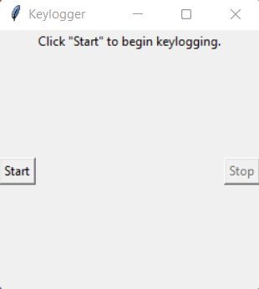
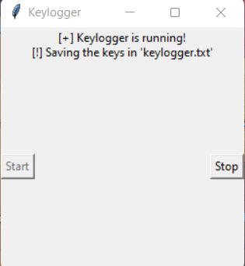
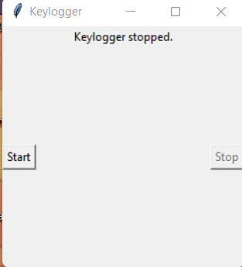
RESULT
The GUI presents "Start" and "Stop" buttons to control the keylogging process. Upon starting, the keylogger captures keystrokes and saves them in designated files. Stopping the keylogger halts the logging process.

Slide 8
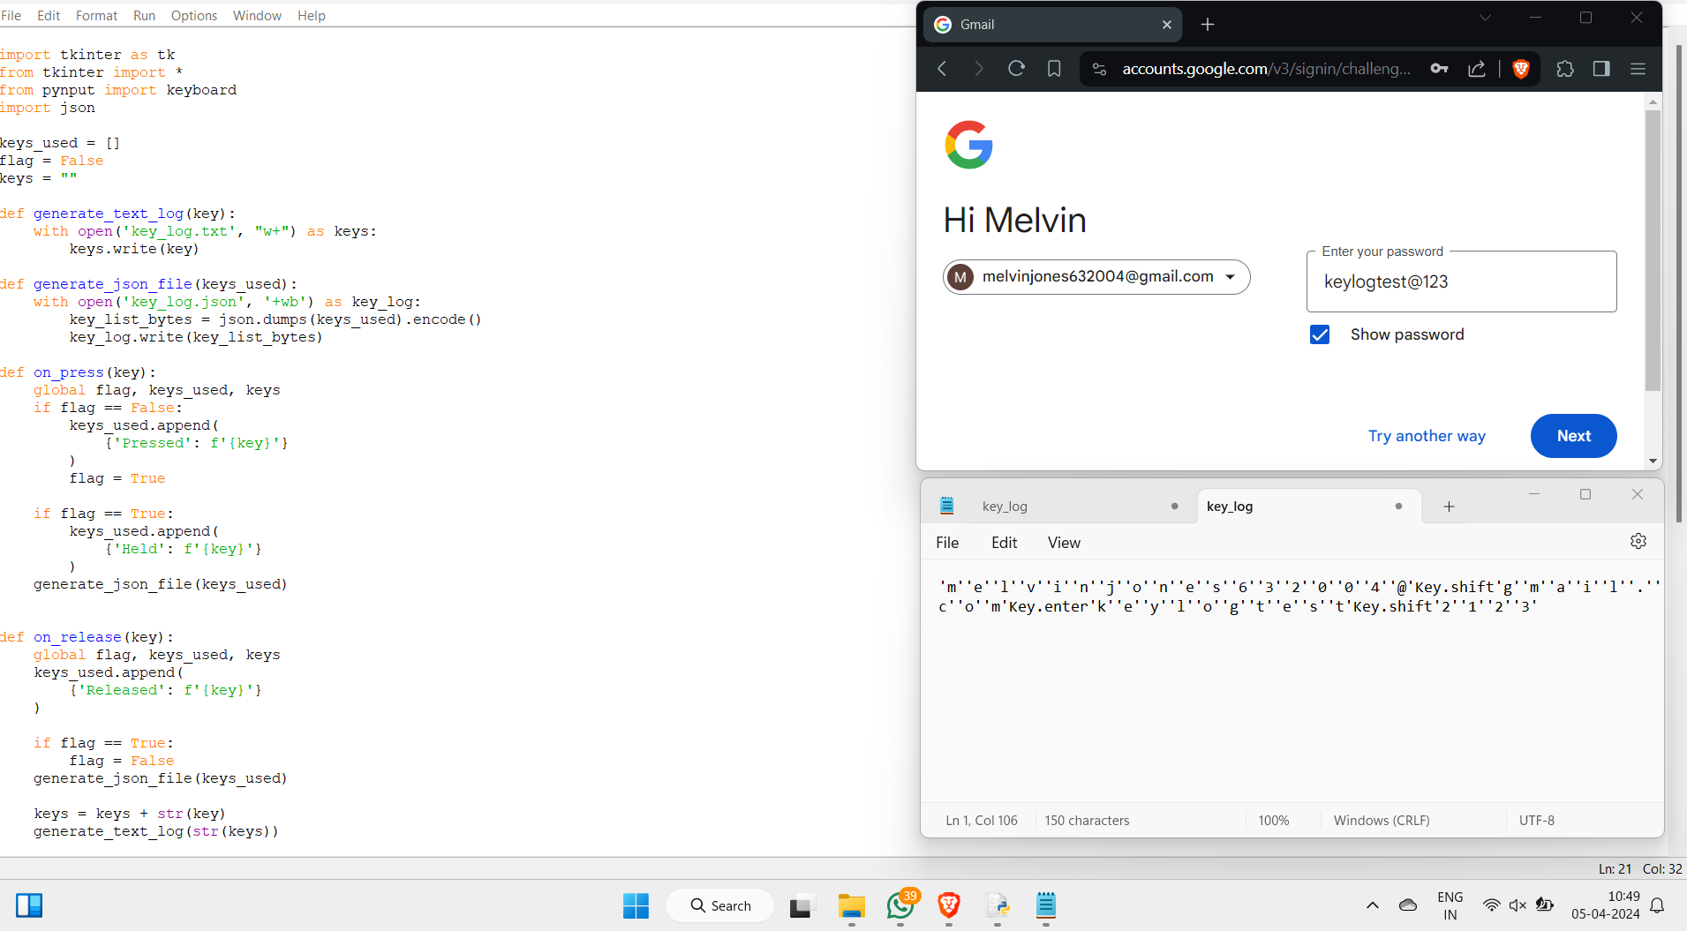
OUTPUT

Slide 9
CONCLUSION
In summary, the prevalence of keyloggers poses a significant threat to cybersecurity, compromising sensitive data and user privacy. Mitigating this risk requires a multi-faceted approach involving robust detection algorithms, encryption protocols, and user awareness programs. Ongoing collaboration among stakeholders is crucial to stay ahead of evolving keylogger techniques and enhance defense mechanisms. By prioritizing proactive measures and adopting innovative solutions, organizations can effectively protect against keylogger attacks and uphold the integrity of digital systems. Vigilance and adaptability remain paramount in the ongoing battle against keylogger threats.

Slide 10
FUTURE SCOPE
Advancements in machine learning will enable more accurate and adaptive keylogger detection methods.
Integration of blockchain technology can enhance data security and authentication processes.
Extension of keylogger detection solutions to encompass emerging platforms such as IoT and cloud environments.
Collaboration among stakeholders is vital for establishing standardized protocols and regulations.

Slide 11
REFERENCES
A Survey on Keylogger and its Detection Techniques by Vishal Bharti, Aditya Kumar Gupta, and Shailendra Mishra https://www.ijcaonline.org/archives/volume75/number5/12835-1514
Analysis of Keylogger Attacks and Countermeasures by Hongliang Liu, Ruiying Du, and Quansheng Zhuang https://www.semanticscholar.org/paper/Analysis-of-Keylogger-Attacks-and-Countermeasures-Liu-Du/54c7255bace229c82e4a5fd812ba8dd8829180c1
Detection of Keyloggers: A Review by Shukor Abd Razak, Ku Ruhana Ku-Mahamud, and Ramlan Mahmod https://www.researchgate.net/publication/220955239_Detection_of_Keyloggers_A_Review
A Comprehensive Study on Keylogger Attack and Defense by Shuo Chen, Rui Wang, XiaoFeng Wang, and Kehuan Zhang https://www.usenix.org/legacy/events/sec11/tech/full_papers/Chen.pdf

Slide 12
THANK YOU

